Slide 1
CS 302 Automata Theory Fall 2018
Text :
Introduction to Automata Theory, Languages and Computation
Third edition, Pearson 2006
Instructor :
Kemal İnan, inan@sabanciuniv.edu
1a

Slide 2
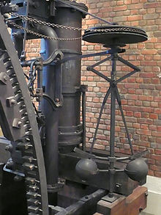
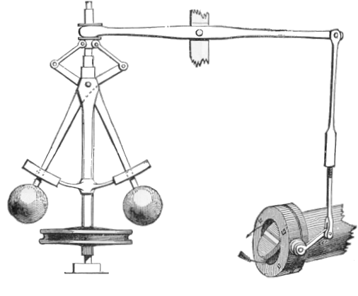
PREMODERN AUTOMATION
James Watt’s Governor (Speed regulator) 1788
flyball operating
with centrifugal force
sensing
Steam Valve Opening
action
Almost a century later :
James Clerk Maxwell’s famous paper (1868) : On Governors
First mathematical treatment of stability
Classical Example of Negative Feedback
1b

Slide 3
Topic of the Course → MODERN : LINGUISTIC BASED AUTOMATION
Sets of legitimate strings (sentences)
Languages
Generation
Of Strings
Acceptance
Of Strings
Grammars
Automata
Equivalence
2

Slide 4
Definition of a Language
(1) A finite set Σ , called the alphabet set.
(2) A set of strings with elements in Σ is called a
language over Σ
3

Slide 5
Formal Definition of a Language L ⊆ Σ* where :
emptystring
Σ* := e ∪ Σ⁺
Σ ⁺ := Σ ∪ Σ ² ∪ … ∪ Σ ^{n} ∪ … = ∪ _{k =1,+∞} Σ ^{k}
where
n times
Σ ^{n} := Σ . Σ . … . Σ := {u₁ u₂ … u_{n} | u_{j}∈Σ , j=1,2,…,n }
= set of all strings with elements in Σ of length n
4

Slide 6
String Operations and Terminology
String Concatenation : u ∈ Σ * , v ∈ Σ * : u .v ∈ Σ *
u ∈ Σ⁺ , v ∈ Σ⁺ and w ∈ Σ⁺ ; s = u . v . w ;
each u,v or w is called a substring of s ;
u is called a prefix of s
w is called a postfix of s
s^{n} denotes s concatenated n times
length (s) = # characters in s = |s|
5

Slide 7
How can we define a language L ?
L := { s ∈ Σ* | F(s) }
A logical condition on s ; F is a truth valued function
There is a problem in this definition :
Is F computable ?
What does computable mean ?
Two computable tools are introduced :
(1) Grammars ;
(2) Automata
6

Slide 8
Examples of languages :
(1) Natural Languages ; strings of characters from a keyboard that are
syntactically correct in English
e.g. The chair ate the elephant is a syntactically correct string (sentence) in the English language
; The ate elephant chair the is not correct !
(2) Formal (Computer) Languages : e.g. strings of symbols that are syntactically correct
; such as a C++ program for which the compiler does not give a syntax error
7

Slide 9
Simpler examples of languages
(3) Well-defined expressions. eg. arithmetic expressions
using the operators + and × and nonnegative integers
(32+560)× (3+54× 7) is correct whereas 32(+056×7(3)) is not correct
(4) Problems : encoding ? of decision ? problems
Examples :
(i) Decision problem :
E = { (n ,m , k) ∈ Z x Z x Z | n+m = k ? } ; E ⊆ Z³
(ii) Encoding of a graph G that solves the decision problem of
connectedness !
8

Slide 10
Context Free Grammars
G = ( V , T , P , S )
Terminal symbols T ⊆ V
Start symbol S ∈ V-T
Finite set of symbols
Finite set of production rules
P ⊆ (V-T) x V*
9

Slide 11
Example : generation of integers in decimal notation
-108970 and +67 and 564 are legitimate strings but 034
and 1-3 and 90+1 are not!
Find a grammar that generates integers in decimal notation !
10

Slide 12
(Deterministic Finite) Automata over a set Σ = {a ,b, c , … }
Simple way to define is by directed graphs where edges are labeled by symbols in Σ
b
initial state
a
c
>
final states
a
b
a
b
a
c
c
b
c
states
11

Slide 13
In CS 302 we use Automata as a language acceptor (or generator)
But there are other uses in modeling real systems :
deliver
change 0.5YTL
(1) Coffee & Chocolate Machine
1 TL
coffee
chocolate
deliver
(2) Digital Integrated Circuits with input and output
n inputs
of 0 and 1
sequences
m outputs
of 0 and 1
sequences
digital circuit with
memory elements (latches)
12

